Slide 1
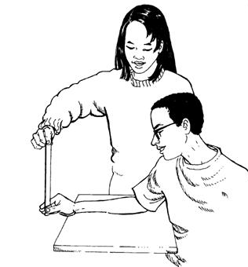
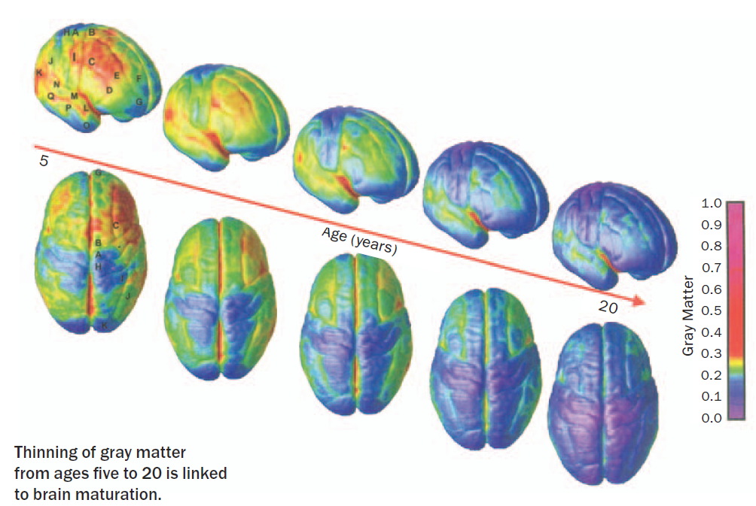
Neurological Disorders Lesson 2.3
How fast do your neurons signal?

Slide 2
Do Now: How fast do your neurons signal?
Use your worksheet to answer the following questions:
What is your reaction time?
How fast do your neurons signal?

Slide 3
What is your reaction time?
To calculate reaction time
National data for 16 – 19 year olds
d = 1/2 at² , where:
d = distance in meters
a = acceleration due to gravity (9.81 m/s²)
t = time in seconds
t = (2d/a)^{1/2}
 | Distance (cm) | Distance (m) | Reaction time (s)
Below Average | 20 - 28 | 0.20 - 0.28 | 0.202 - 0.239
Average | 16 - 20 | 0.16 - 0.20 | 0.181 - 0.202
Above Average | 7 - 16 | 0.07 - 0.16 | 0.119 - 0.181
Excellent | < 7 | < 0.07 | < 0.119

Slide 4
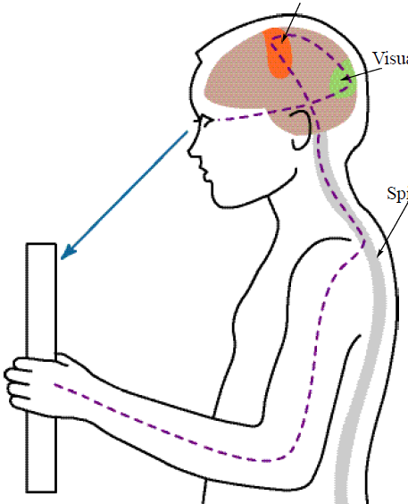
How far does the neural signal travel?
Motor cortex
Eyes to occipital lobe 20 cm
Occipital lobe to motor cortex 15 cm
Motor cortex to spinal cord 50 cm
Spinal cord to motor neuron 95 cm
Total neural distance 180 cm = 1.8 m
Occipital lobe
Spinal
cord

Slide 5
How fast do your neurons signal?
Total neural distance = 1.8 m
Reaction time = 0.192 s
Speed of neural signal = Distance / Time
= 1.8 m / 0.192 s
= 9.4 m/s
But wait, scientists have measured the speed of the action potential to be as “slow” as 0.5 m/s… and 0.5 m/s <<< 9.4 m/s

Slide 6
What slows down axonal signaling?
The membrane is leaky, so signals decay…
With more channels, axons use a lot of energy…

Slide 7
How could you fix both problems and speed up axonal signaling?

Slide 8
How could you fix both problems and speed up axonal signaling?
Add a coating to insulate the axon.
Prevents leakiness
Saves energy
Insulation

Slide 9
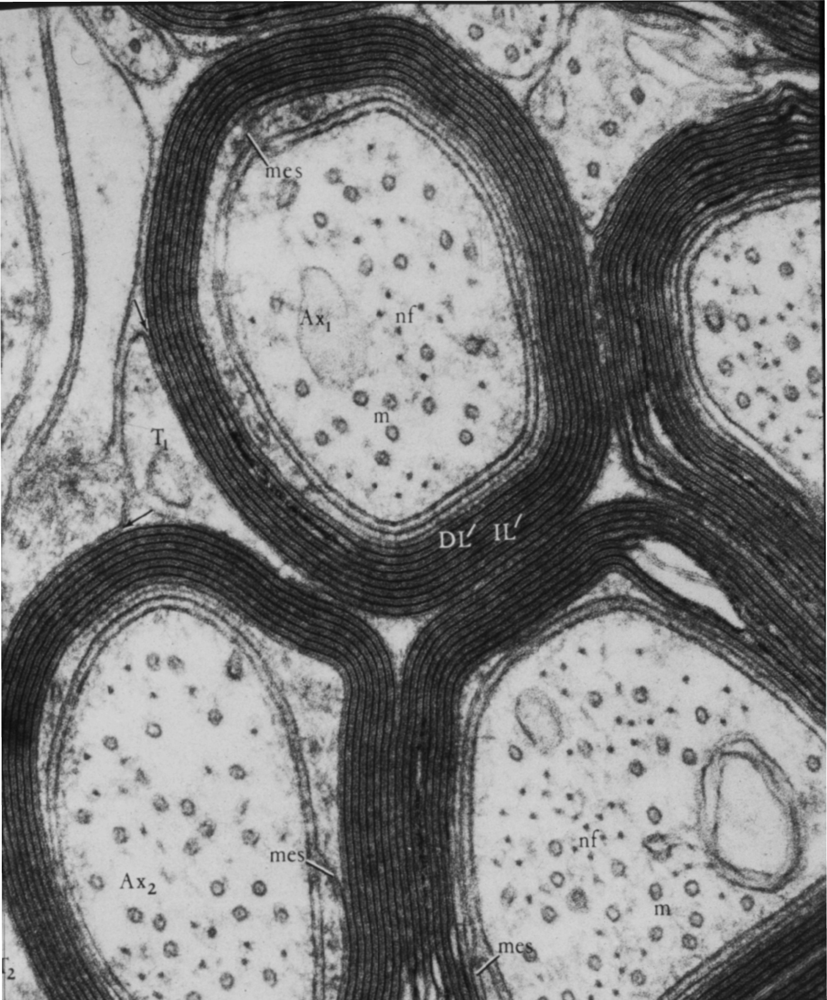
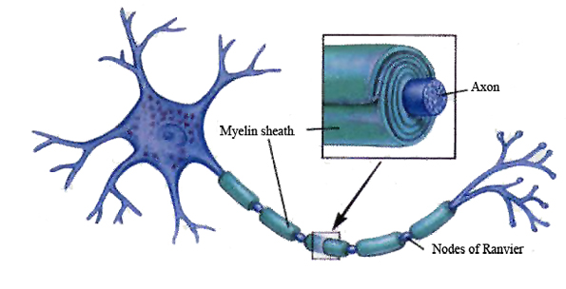
Myelin: The axon’s insulation
Myelin
Axon
Axon
Myelin
Node of Ranvier

Slide 10
Notes! Myelin: The axon’s insulation
An unmyelinated axon can signal at speeds of 0.5 m/s. (That’s 1 mph.)
A myelinated axon can signal at speeds of 150 m/s (That’s 335 mph.)
Which would you rather have – myelinated or unmyelinated axons?

Slide 11
What happens when myelin gets damaged?
Healthy neuron
Multiple Sclerosis
Damaged
Myelin
Myelin

Slide 12
When does myelination occur?
As grey matter is lost, white matter is gained.
Loss of Grey Matter from 5 – 20 years
Mostly grey matter
Mostly white matter

Slide 13
What do you think?
Research shows that the human brain, specifically the frontal lobe, is not heavily myelinated until the age of 20.
Some scientists argue that teenagers show poor judgment because their brains aren’t fully myelinated.
What do you think? Do you agree with the scientists’ arguments? Do you think there could be another explanation?

